Slide 1
CIS 530: Vector Semantics
Jurafsky and Martin Chapter 6

Slide 2
Reminders
Quiz 2 on n-gram LMs is due tonight before 11:59pm.
Homework 3 is due on Wednesday
Read Textbook Chapters 3 and 6

Slide 3
Word Meaning
How should we represent the meaning of a word?
In N-gram LMs we represented words as a string of letters or as an index in a vocabulary list.
Ideally, we want a meaning representation to encode:
Synonyms – words that have similar meanings
Antonyms – words that have opposite meanings
Connotations – words that are positive or negative
Semantic Roles – buy, sell, and pay are different parts of the same underlying purchasing event
Support for inference
Notes:
(If I buy something from you, you’ve probably sold it to me, and I likely paid you).

Slide 4
Dictionary Definitions
Noun
A small insect.
A harmful microorganism, as a bacterium or virus.
An enthusiastic, almost obsessive, interest in something. ‘they caught the sailing bug’
A miniature microphone, typically concealed in a room or telephone, used for surveillance.
An error in a computer program or system.
Verb
Conceal a miniature microphone in (a room or telephone) in order to monitor or record someone's conversations.
Annoy or bother (someone)
Notes:
Here the form bug is the lemma, also called the citation form. The form bug would also be the lemma for the word bugs; dictionaries don’t have separate definitions for inflected forms. Similarly sing is the lemma for sing, sang, sung. In many languages the infinitive form is used as the lemma for the verb, so Spanish dormir “to sleep” is the lemma for duermes “you sleep”. The specific forms sung or carpets or sing or duermes are called wordforms.

Slide 5
Polysemy
A lemma that has multiple meanings is called polysemous. We call each of these aspects of the meaning of bug a word sense.
Polysemy can make interpretation difficult.
What if someone types “caught a bug” into Google?
Word sense disambiguation is the task of determining which sense of a word is being used in a context.

Slide 6
Synonymy
When one word has a sense whose meaning is nearly identical to a sense of another word then those two words are synonyms.
glitch/error
microbe/bacterium
insect/pest
microphone/wire
Formally, two words are synonymous if they are substitutable one for the other in any sentence without changing the truth conditions of the sentence.
In logic, that means the two words carry the same propositional meaning.
Notes:
That means that all the situations in which the original sentence would be true, the sentence with the substitution would also be true.

Slide 7
Principle of Contrast
Linguists assume that a difference in form is always associated with a difference in meaning.
While substitutions like water/H₂O or father/dad are truth preserving, the words are still not identical in meaning.
H₂O is used in scientific contexts, but not general texts like hiking guides
Father is a more formal version of dad.
It is possible that no two words have absolutely identical meaning.

Slide 8
Word similarity
Most words don’t have many synonyms, but they do have a lot of similar words. Cat is not a synonym of dog, but cats and dogs are certainly similar words.
“fast” is similar to “rapid”
“tall” is similar to “height”
Useful for applications like question answering
Notes:
In moving from synonymy to similarity, it will be useful to shift from talking about relations between word senses (like synonymy) to relations between words (like similarity). Dealing with words avoids having to commit to a particular representation of word senses, which will turn out to simplify our task.

Slide 9
Word similarity
Most words don’t have many synonyms, but they do have a lot of similar words. Cat is not a synonym of dog, but cats and dogs are certainly similar words.
“fast” is similar to “rapid”
“tall” is similar to “height”
Useful for applications like Question Answering
Notes:
In moving from synonymy to similarity, it will be useful to shift from talking about relations between word senses (like synonymy) to relations between words (like similarity). Dealing with words avoids having to commit to a particular representation of word senses, which will turn out to simplify our task.

Slide 10
Word similarity
Can similar words be substituted in any sentence without changing its truth conditions? No.
How can we measure whether words are similar? One way is to ask humans to judge how similar one word is to another.
Word 1 | Word 2 | Similarity Score
Vanish | Disappear | 9.8
Tiger | Cat | 7.4
Love | Sex | 6.8
Muscle | Bone | 3.6
Cucumber | Professor | 0.3
Notes:
SimLex-999 dataset (Hill et al., 2015) gives values on a scale from 0 to 10, like the examples below, which range from near-synonyms (vanish, disappear) to pairs that scarcely seem to have anything in common (hole, agreement):

Slide 11
Word Relatedness
Words can still be related in ways other than being similar to each other.
Coffee and Cup are not similar because they don’t share any features
coffee is a plant or a beverage,
cup is a manufactured object made in a useful shape
But they’re related by co-participating in the same event.
Relatedness is measured with word association tests in psychology.
A semantic field is a set of words which cover a semantic domain and bear structured relations with each other.
Hospitals: surgeon, scalpel, nurse, anesthetic, hospital Restaurants: waiter, menu, plate, food, chef Houses: family, door, roof, kitchen, bed

Slide 12
Semantic Roles
An event like a commercial transaction described with different verbs
buy (the event from the perspective of the buyer),
sell (from the perspective of the seller),
pay (focusing on the monetary aspect),
Or with nouns like buyer.
Frames encode semantic roles (like buyer, seller, goods, money), and the words in a sentence that take on these roles.
Notes:
Closely related to semantic fields is the idea of a semantic frame. A semantic frame is a set of words that denote perspectives or participants in a particular type of event.
Knowing that buy and sell have this relation makes it possible for a system to know that a sentence like Sam bought the book from Ling could be paraphrased as Ling sold the book to Sam, and that Sam has the role of the buyer in the frame and Ling the seller. Being able to recognize such paraphrases is important for question answering, and can help in shifting perspective for machine translation.

Slide 13
Connotation
Words have affective meanings or connotations. Three important dimensions of affective meaning.
Valence – the pleasantness of the stimulus
Arousal – the intensity of emotion provoked by the stimulus
Dominance – the degree of control exerted by the stimulus
 | Valence | Arousal | Dominance
courageous | 8.05 | 5.5 | 7.38
music | 7.67 | 5.57 | 6.5
heartbreak | 2.45 | 5.65 | 3.58
cub | 6.71 | 3.95 | 4.24
life | 6.68 | 5.59 | 5.89

Slide 14
Points in space
Osgood et al. (1957) noticed that in using these 3 numbers to represent the meaning of a word, the model was representing each word as a point in a three-dimensional space
Part of the meaning of heartbreak can be represented as a vector with three dimensions corresponded to the word’s rating on the three scales.
heartbreak | 2.45 | 5.65 | 3.58

Slide 15
Vector Space Models
Notes:
The idea of the VSM is to represent each word as a point in a space (a vector in a vector space). Points that are close together in this space are semantically similar and points that are far apart are semantically distant.

Slide 16
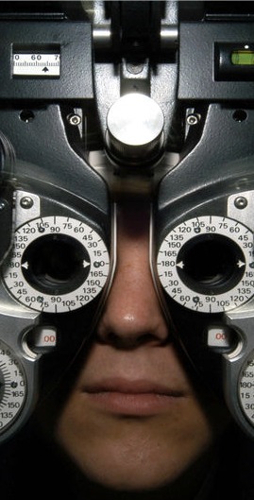
Distributional Hypothesis
If we consider optometrist and eye-doctor we find that, as our corpus of utterances grows, these two occur in almost the same environments. In contrast, there are many sentence environments in which optometrist occurs but lawyer does not...
It is a question of the relative frequency of such environments, and of what we will obtain if we ask an informant to substitute any word he wishes for optometrist (not asking what words have the same meaning).
These and similar tests all measure the probability of particular environments occurring with particular elements... If A and B have almost identical environments we say that they are synonyms.
–Zellig Harris (1954)
Notes:
Similar messages expressed by Wittgenstein (1953) and Firth (1957) who said “You shall know a word by the company it keeps.”
VSMs are interesting especially due to their relation with the distributional hypothesis and related hypotheses. The distributional hypothesis is that words that occur in similar contexts tend to have similar meanings. Efforts to apply this abstract hypothesis to concrete algorithms for measuring the similarity of meaning often lead to vectors, matrices, and higher-order tensors.

Slide 17
Intuition of distributional word similarity
Nida (1975) example: A bottle of tesgüino is on the table Everybody likes tesgüino Tesgüino makes you drunk We make tesgüino out of corn.
From context words humans can guess tesgüino means an alcoholic beverage like beer
Intuition for algorithm: Two words are similar if they have similar word contexts.

Slide 18
Information Retrieval
Vector Space Models were initially developed in the SMART information retrieval system (Salton, 1971)
Each document in a collection is represented as point in a space (a vector in a vector space)
A user’s query is a pseudo-document and is represented as a point in the same space as the documents
Perform IR by retrieving documents whose vectors are close together in this space to the query vector
Notes:
SMART pioneered many of the concepts that are used in modern search engines
The idea of vector space models stems from Information Retrieval (IR) where instead of representing words as points in space, we represent documents as points in space, and a query can be represented as a point in the same space as the documents (the query is a pseudo- document). Then we return a sorted list of documents, starting with the document that is closest in space to the query.

Slide 19
Term-Document Matrix
 | D1 | D2 | D3 | D4 | D5
abandon
abdicate
abhor
academic
…
zygodactyl
zymurgy
Notes:
Documents can be things like Shakespeare’s plays, or novels, or web pages

Slide 20


Term-Document Matrix
 | D1 | D2 | D3 | D4 | D5
abandon
abdicate
abhor
academic
…
zygodactyl
zymurgy
Each column vector
represents a Document
Notes:
Documents can be things like Shakespeare’s plays, or Wikipedia pages, or IMDB reviews for a movie.

Slide 21
Term-Document Matrix
 | D1 | D2 | D3 | D4 | D5
abandon
abdicate
abhor
academic
…
zygodactyl
zymurgy
Each row vector
represents a Term

Slide 22


Term-Document Matrix
 | D1 | D2 | D3 | D4 | D5
abandon
abdicate
abhor
academic
…
zygodactyl
zymurgy
The value in a cell is
based on how often that term
occurred in that document

Slide 23

Term-Document Matrix
}
 | D1 | D2 | D3 | D4 | D5
abandon
abdicate
abhor
academic
…
zygodactyl
zymurgy
The length of the
document vectors
is the size of the vocabulary

Slide 24
Term-Document Matrix
 | D1 | D2 | D3 | D4 | D5
abandon
abdicate
abhor
academic
…
zygodactyl
zymurgy
Document vectors
can be sparse
(most values are 0)

Slide 25


Term-Document Matrix
 | D1 | D2 | D3 | D4 | D5
abandon
abdicate
abhor
academic
…
zygodactyl
zymurgy
We can measure
how similar two
documents are
by comparing their
column vectors

Slide 26
What can document similarity let you do?
Notes:
Ask this question of students, write down their answers. Here are some:
Authorship attribution
Plagiarism detection
Document de-duplication
Compare documents by "tone"
IR where query = document

Slide 27
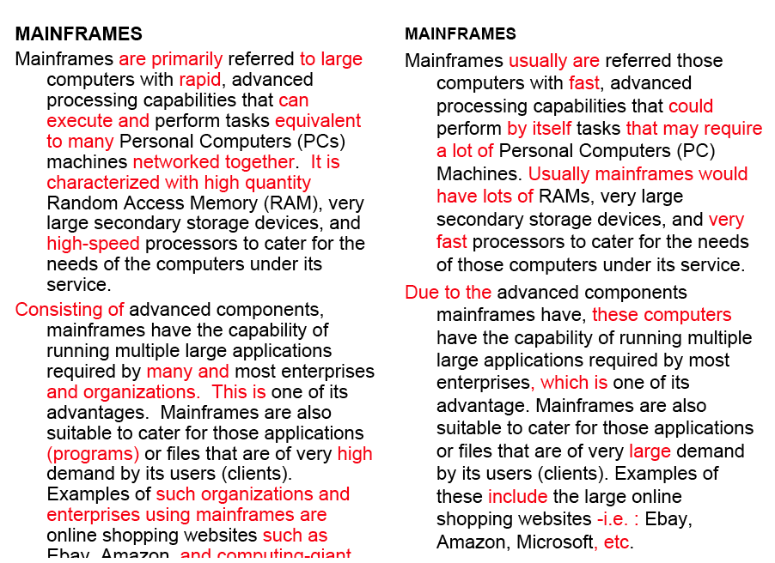
Word similarity for plagiarism detection

Slide 28



Term-Document Matrix
 | D1 | D2 | D3 | D4 | D5
abandon
abdicate
abhor
academic
…
zygodactyl
zymurgy
What does comparing
two row vectors do?
Notes:
It measures the similarity between words!

Slide 29
Vector comparisons
 | docX | docY
A | 2 | 4
B | 10 | 15
C | 14 | 10
Notes:
docY is a positive movie review
docx is a less positive movie review
A = "superb" positive / low frequency
B = "good" positive / high frequency
C = "disappointing" negative / high frequency

Slide 30
Vector comparisons
 | docX | docY
A | 2 | 4
B | 10 | 15
C | 14 | 10
docY is a positive movie review
docx is a less positive movie review
A = "superb" positive / low frequency
B = "good" positive / high frequency
C = "disappointing" negative / high frequency
Notes:
docY is a positive movie review
docx is a less positive movie review
A = "superb" positive / low frequency
B = "good" positive / high frequency
C = "disappointing" negative / high frequency

Slide 31
Vector comparisons
 | docX | docY
A | 2 | 4
B | 10 | 15
C | 14 | 10
Notes:
Euclidean distance : vectors u, v of dimension N
sqrt (sum_i to N ( | ui - vi|² ) )
A to B is sqrt of | 2-10 |² + | 4-15 |² = 13.6
B to C is sqrt of | 10-14 |² + | 15-10 |² = 6.4
A = Superb, B = Good, C=Disappointing
Goal: related words are close, and unrelated words are far apart.
Did we do it?

Slide 32
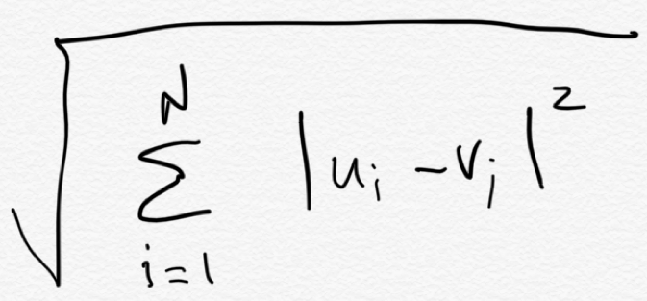
Vector comparisons
Euclidean distance
 | docX | docY
A | 2 | 4
B | 10 | 15
C | 14 | 10
B
distance = 6.4
distance = 13.6
C
Euclidean distance : vectors u, v of dimension N
A

Slide 33
Vector comparisons
Oh no! Good is
closer to Disappointing
than to Superb.
Euclidean distance
 | docX | docY
A | 2 | 4
B | 10 | 15
C | 14 | 10
B = Good
distance = 6.4
distance = 13.6
C = Disappointing
Euclidean distance : vectors u, v of dimension N
A = Superb

Slide 34
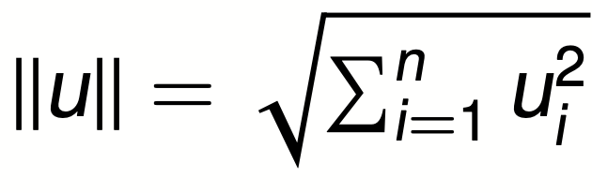
Vector L2 (length) Normalization
 | docX | docY
A | 2 | 4
B | 10 | 15
C | 14 | 10
||u||
4.47
18.02
17.20

Slide 35
Vector L2 (length) Normalization
 | docX | docY
A | 2/4.47 | 4/4.47
B | 10/18.02 | 15/18.02
C | 14/17.2 | 10/17.2
||u||
4.47
18.02
17.20
Divide each vector by its L2 length

Slide 36
Vector comparisons
 | docX | docY
A | 2 | 4
B | 10 | 15
C | 14 | 10
Notes:
Euclidean distance : vectors u, v of dimension N
sqrt (sum_i to N ( | ui - vi|² ) )
A to B is sqrt of | 2-10 |² + | 4-15 |² = 13.6
B to C is sqrt of | 10-14 |² + | 15-10 |² = 6.4
A = Superb, B = Good, C=Disappointing
Goal: related words are close, and unrelated words are far apart.
Did we do it?

Slide 37
Vector L2 (length) Normalization
 | docX | docY
Ȧ | 0.45 | 0.89
Ḃ | 0.55 | 0.83
Ċ | 0.81 | 0.58
A = Superb
B = Good
C = Disappointing
Now Good is
closer to Superb
than to Disappointing

Slide 38
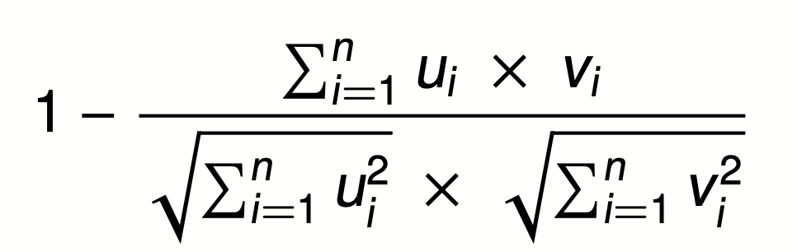

Cosine Distance
A = Superb
B = Good
C = Disappointing
Cosine does the L2
normalization too
Cosine angle between
vectors tells us their similarity

Slide 39
Term-Term Matrix
 | abandon | abdicate | abhor | … | zymurgy
abandon
abdicate
abhor
academic
…
zygodactyl
zymurgy
Notes:
Defines a co-occurrence matrix
w-2, w-1 target word w+1 w+2

Slide 40
Term-Term Matrix
AKA Term-Context Matrix
 | abandon | abdicate | abhor | … | zymurgy
abandon
abdicate
abhor
academic
…
zygodactyl
zymurgy
Length of the vector is now |V|
instead of number of documents
Notes:
|V| = size of vocabulary

Slide 41
Term-Term Matrix
AKA Term-Context Matrix
back | abandon | abdicate | abhor | … | zymurgy
abandon
abdicate
abhor
academic
…
zygodactyl
zymurgy
The value in a cell indicates how
often abandon appears in a
context window surrounding
abdicate
Notes:
Defines a co-occurrence matrix
w-2, w-1 target word w+1 w+2

Slide 42
Context windows
w-2, w-1 target_word w+1 w+2
The government most not abdicate responsibility to non-elected
it has led men to abdicate their family responsibilities
other demands, but declining to abdicate his responsibility
leaders abdicate their role and present people with no plans
 | his | leaders | not | responsibility | to
abandon | 1 | 1 | 1 | 2 | 3
Notes:
Defines a co-occurrence matrix
w-2, w-1 target word w+1 w+2

Slide 43
Context windows
Occur in a window of +/- 2 words, in the same sentence, in the same document
Instead of window of words use more complex contexts: dependency patters. Subj-of-verb, adj-mod, obj-of-verb
Languages have long distance dependencies The pictures are beautiful. The pictures of the old man are beautiful. The pictures of the old man holding his grandchild are beautiful.
Notes:
Defines a co-occurrence matrix
w-2, w-1 target word w+1 w+2

Slide 44
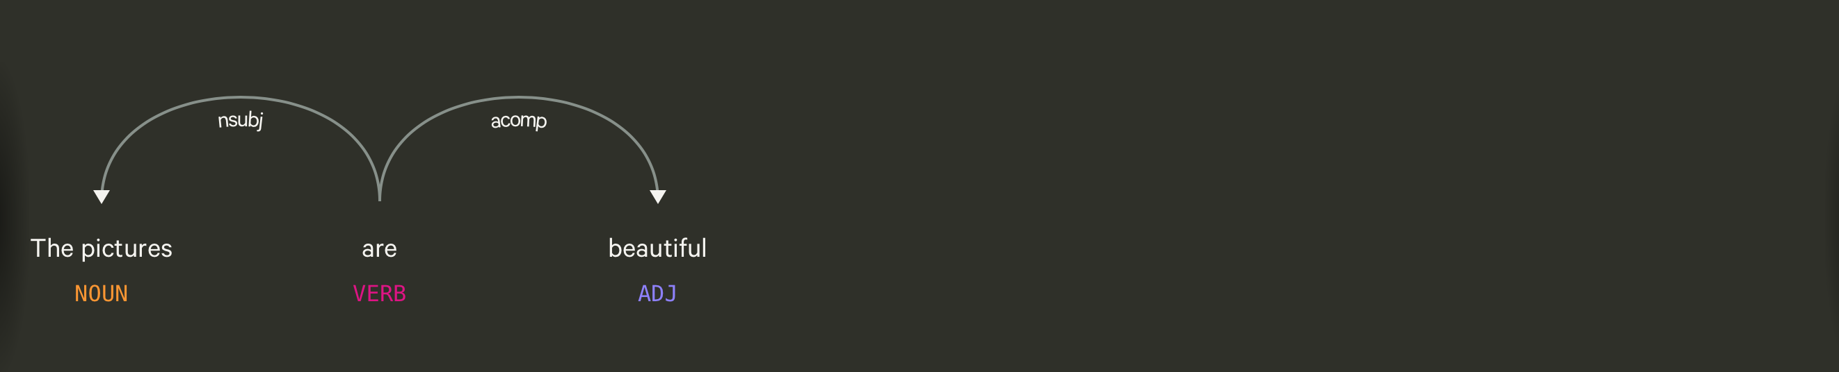
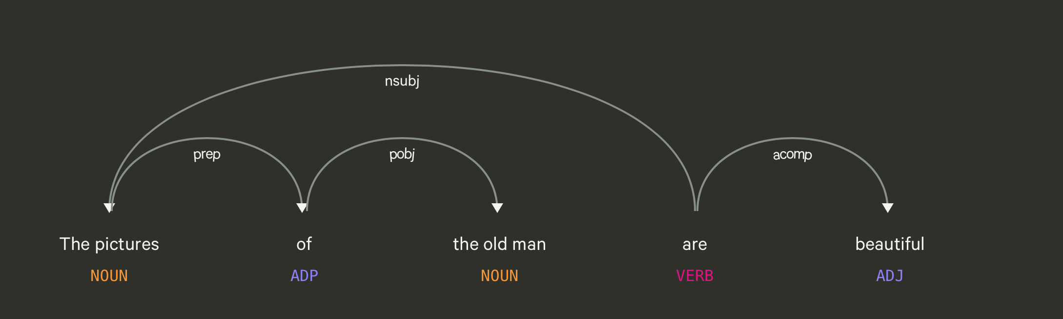
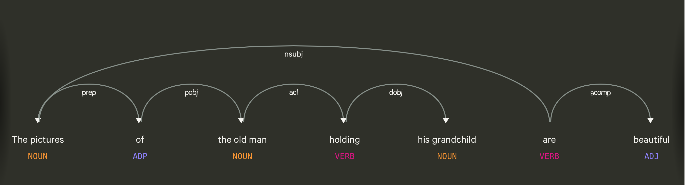

Slide 45
Using syntax to define a word’s context
Zellig Harris (1968) “The meaning of entities, and the meaning of grammatical relations among them, is related to the restriction of combinations of these entities relative to other entities”
Duty and Responsibility have similar syntactic distributions
Modified by adjectives | additional, administrative, assumed, collective, congressional, constitutional …
Object of verbs | assert, assign, assume, attend to, avoid, become, breach..

Slide 46
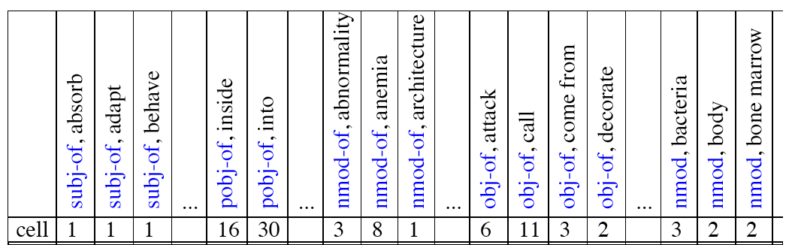
Co-occurrence vectors based on syntactic dependencies
Dekang Lin, 1998 “Automatic Retrieval and Clustering of Similar Words”

Slide 47
Alternates to counts
Raw word frequency is not a great measure of association between words. It’s very skewed “the” and “of” are very frequent, but maybe not the most discriminative
We’d rather have a measure that asks whether a context word is particularly informative about the target word.
Instead of raw counts, it’s common to transform vectors using TF-IDF or PPMI
Notes:
I’m going to skip the definition of PPMI for this talk

Slide 48


TF-IDF
Term frequency * inverse document frequency
How often a
word occurred in
a document
1 over the number
of documents that it
occurred in
Notes:
What does this do to a word like the?

Slide 49
Sparse v. Dense Vectors
Co-occurrence matrix (weighted by TF-IDF or mutual information)
Long (length |V| = 50,000+)
Sparse (most elements are zeros)
Alternative: learn vectors that are
Short (length 200-1000)
Dense (most elements are non-zero)
Notes:
ccb - future todo - Re-work as a visual?

Slide 50
How do we get dense vectors?
One recipe: train a classifier!
1. Treat the target word and a neighboring context word as positive examples.
2. Randomly sample other words in the lexicon to get negative samples.
3. Use logistic regression (similar to Perceptron, but output values range between 0-1) to train a classifier to distinguish those two cases.
4. Use the weights as the embeddings.

Slide 51
Skip-grams, CBOW
Mikolov et al. 2013
Learn embeddings as part of the process of word prediction.
Train a classifier to predict neighboring words
Inspired by neural net language models.
In so doing, learn dense embeddings for the words in the training corpus.
Advantages:
Fast, easy to train (much faster than SVD)
Available online in the word2vec package
Including sets of pretrained embeddings!

Slide 52
Skip-Grams
Predict each neighboring word in a context window of 2C of surrounding words
So for C=2, we are given a word wt and we try to predict its 4 surrounding words
[wt-2, wt-1, wt+1, wt+2]
Uses "negative sampling" for training

Slide 53
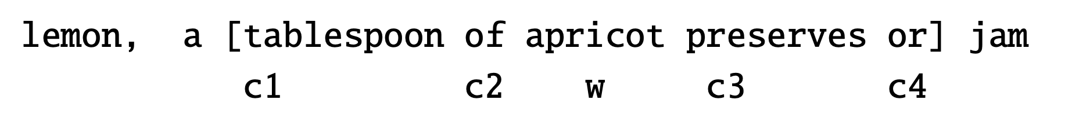

Negative sampling
We want predictions
of these words to be high
And these words to be low

Slide 54
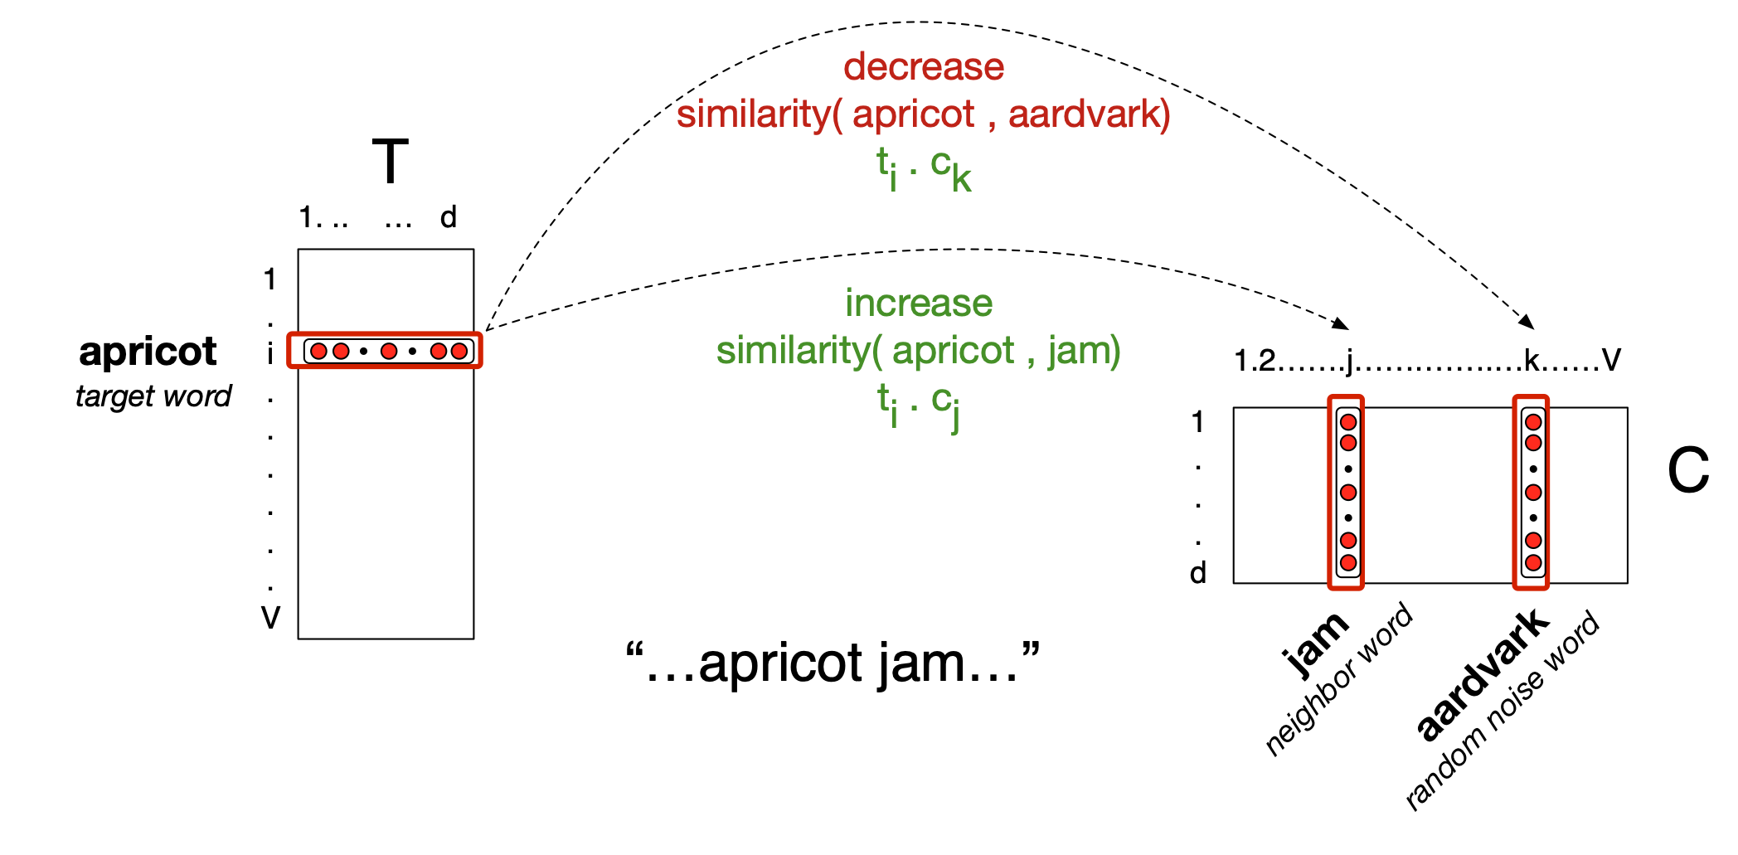
Neural Network

Slide 55
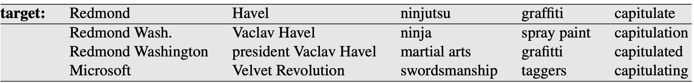
Properties of Embeddings
Nearest Neighbors are surprisingly good

Slide 56
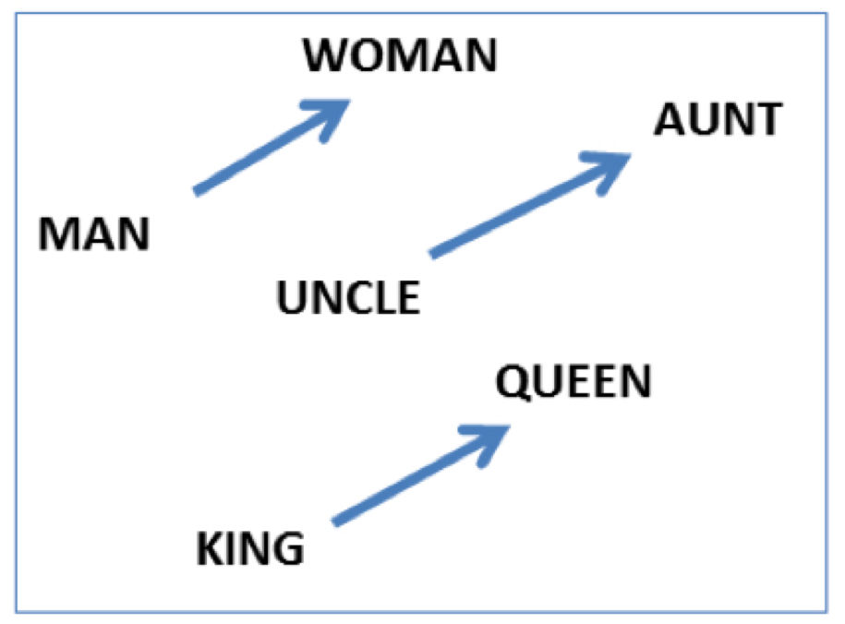
Embeddings capture relational meanings
.vector('king') - vector('man') + vector('queen') ≅ vector('woman')

Slide 57
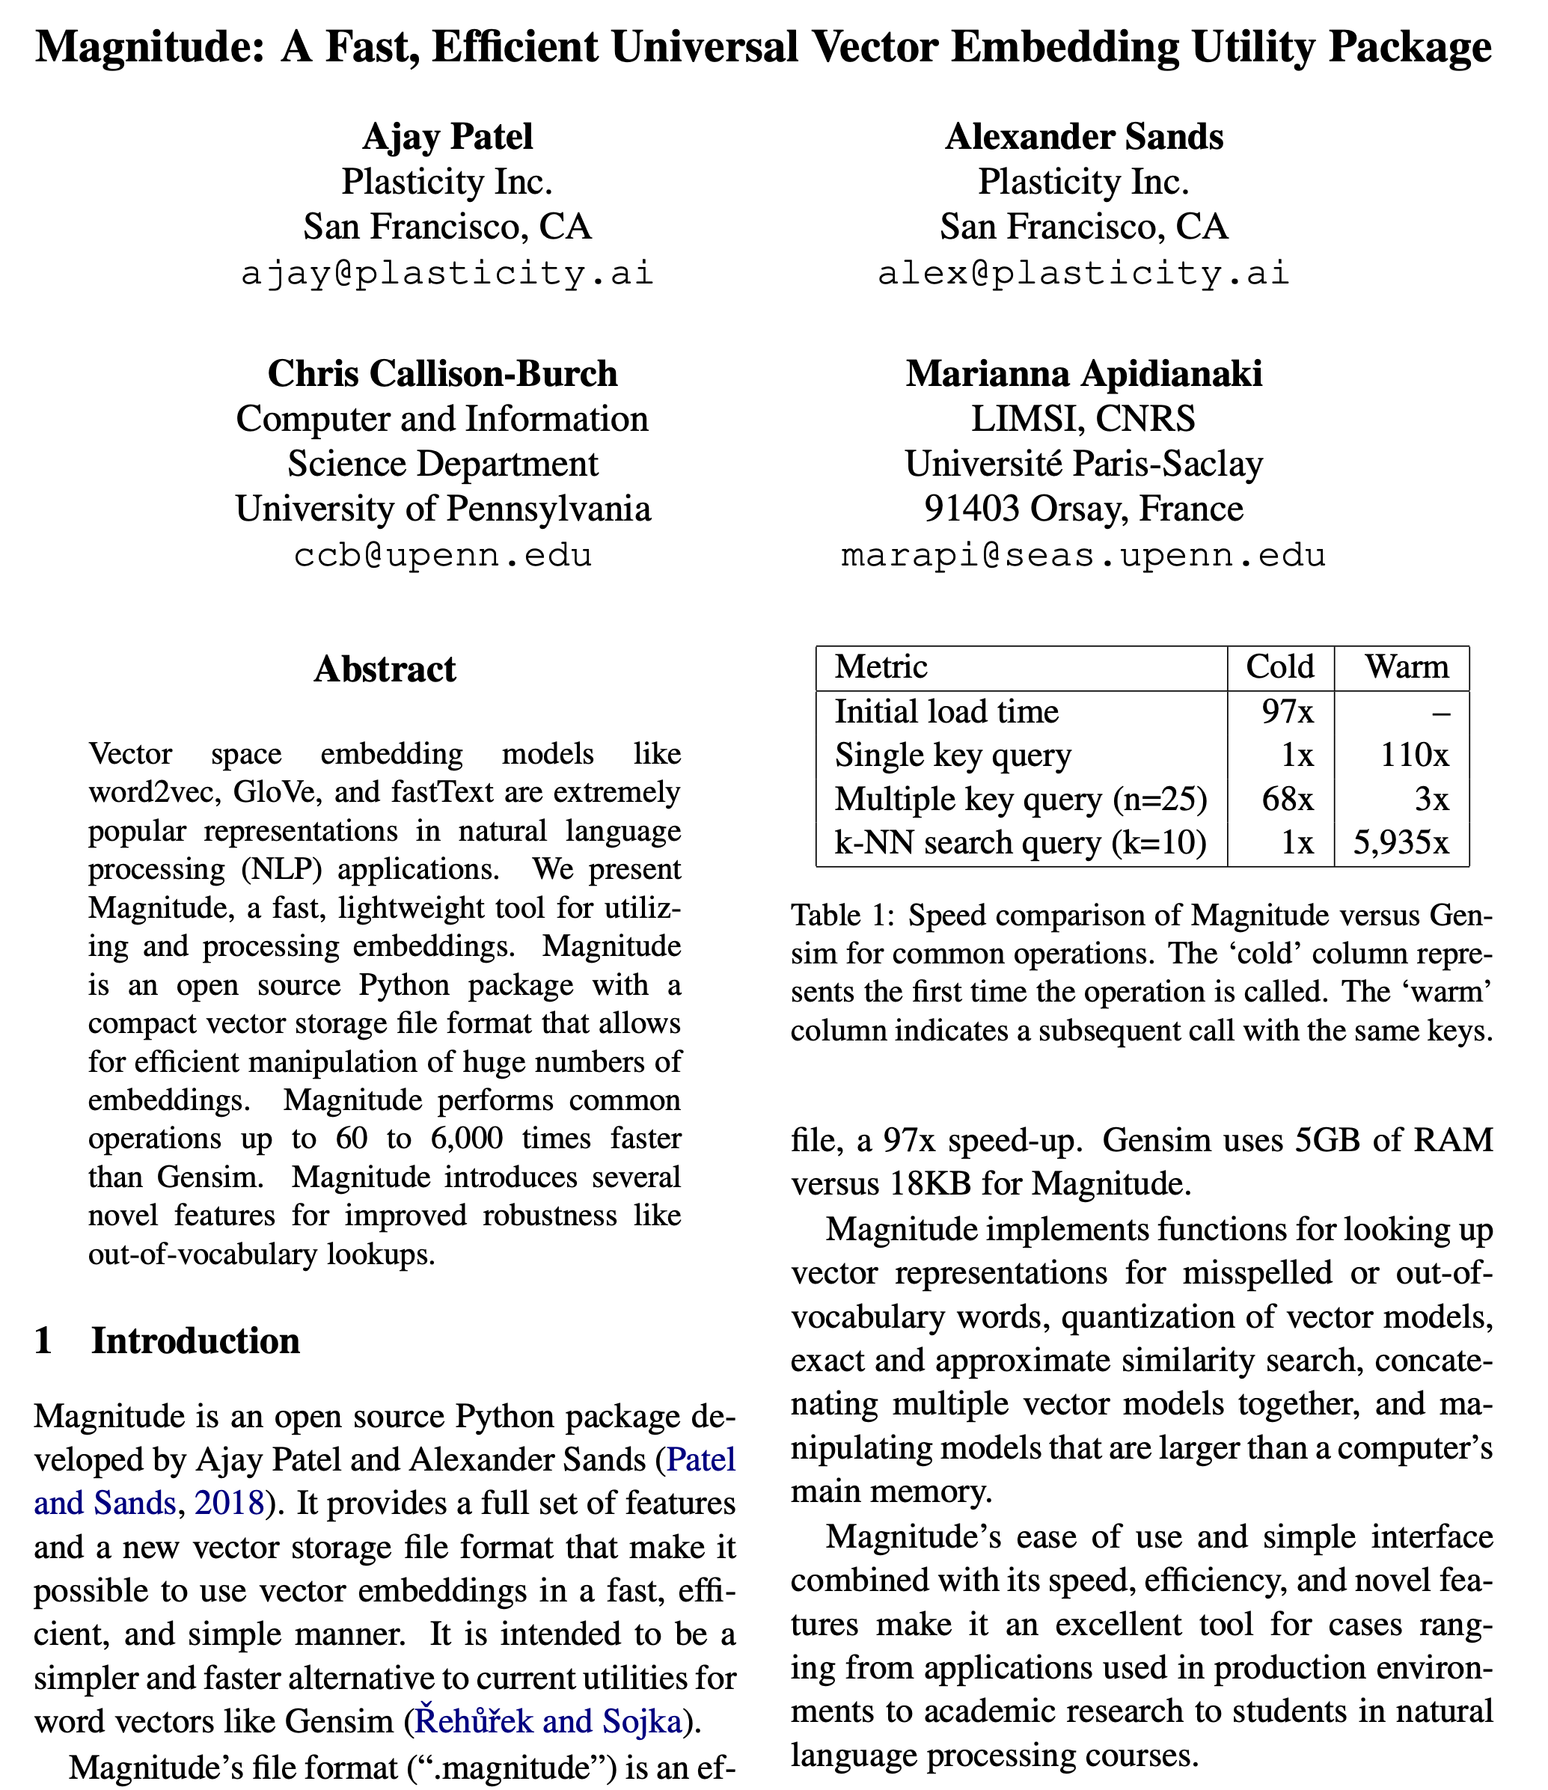

Slide 58
Demo of word vectors
# Install Magnitude
pip3 install pymagnitude
# Download Google’s word2vec vectors
wget http://magnitude.plasticity.ai/word2vec+approx/GoogleNews-vectors-negative300.magnitude
# Warning it’s 11GB large
# Start Python, and try the commands
# on the next slide
python3

Slide 59
Demo of word vectors
from pymagnitude import *
vectors = Magnitude("GoogleNews-vectors-negative300-2.magnitude")
queen = vectors.query('queen')
king = vectors.query("king")
vectors.similarity(king, queen)
# 0.6510958
vectors.most_similar_approx(king, topn=5)
#[('king', 1.0), ('kings', 0.72), ('prince', 0.62), ('sultan', 0.59), ('ruler', 0.58)]

Slide 60
Many possible models
Matrix type
Term-document
Term-context
Pattern-pair
Reweighting
length norm.
TF-IDF
PPMI
probabilities
Comparisons
cosine
Manhattan
Jaccard
KL divergence
JS distance
DICE
Dim. Reduction
word2vec
GloVe
PCA
LDA
LSA

Slide 61
Many possible models
Matrix type
Term-document
Term-context
Pattern-pair
Reweighting
length norm.
TF-IDF
PPMI
probabilities
Comparisons
cosine
Manhattan
Jaccard
KL divergence
JS distance
DICE
Dim. Reduction
word2vec
GloVe
PCA
LDA
LSA
How many dimensions?
What modifications should we make to the input?
Notes:
Modifications: tokenization/normalization, annotation/tagger, parsing, cluster text by author/time/etc.

Slide 62
How do we pick the right combination?
Notes:
Ask students.
Trial and error?

Slide 63
Evaluating word vectors
2 kinds of evaluation:
1) Extrinsic evaluation = task based
2) Intrinsic
Notes:
Ask students.
Trial and error?

Slide 64
Psycholinguistics Data
Cos sim | U | V | Judgements
… | Love | Sex | 6.8
 | Tiger | Cat | 7.3
 | Tiger | Tiger | 10
 | Fertility | Egg | 6.7
 | Stock | Egg | 1.8
 | Professor | Cucumber | 0.3

Slide 65
Computing correlation
Human ordering
Love | Sex
>
Professor | Cucumber
System ordering predicts
< … this is a discordant pair
> … this is a concordant pair
Notes:
range -1 to 1

Slide 66
Does similarity == semantics?
Word vectors fail to capture logical implications Dog(x) → Animal(x) Dog(x) → not (Gorilla(x))
Word vectors for antonyms or logically exclusive things are often very similar sim(boys, girls) sim(cats, dogs) sim(France, Germany) sim(rise, fall)

Slide 67
Acknowledgements
Thanks to the following people for providing slides
Dan Jurafsky from his textbook Speech and Language Processing version 3
Peter Turney and Patrick Pantel From Frequency to Meaning: Vector Space Models of Semantics
Chris Potts from his course CS224U: Natural Language Understanding
Denis Paperno, Marco Baroni, German Kruszewski from their talk on Deriving Boolean Structures from Distributional Vectors

Slide 68
Vector Semantics
Read Chapter 6 of
Speech and Language Processing (3rd ed draft)
Notes:
Comparing rows

Slide 69
Why vector models of meaning? Computing the similarity between words
“fast” is similar to “rapid”
“tall” is similar to “height”
Question answering:
Q: “How tall is Mt. Everest?” Candidate A: “The official height of Mount Everest is 29029 feet”

Slide 70
Word similarity for plagiarism detection

Slide 71
Distributional models of meaning = vector-space models of meaning = vector semantics
Intuitions: Zellig Harris (1954):
“oculist and eye-doctor … occur in almost the same environments”
“If A and B have almost identical environments we say that they are synonyms.”
Firth (1957):
“You shall know a word by the company it keeps!”

Slide 72
Intuition of distributional word similarity
Nida example:
A bottle of tesgüino is on the table
Everybody likes tesgüino
Tesgüino makes you drunk
We make tesgüino out of corn.
From context words humans can guess tesgüino means
an alcoholic beverage like beer
Intuition for algorithm:
Two words are similar if they have similar word contexts.

Slide 73
Intuition
Model the meaning of a word by “embedding” in a vector space.
The meaning of a word is a vector of numbers
Vector models are also called “embeddings”.
Contrast: word meaning is represented in many computational linguistic applications by a vocabulary index (“word number 545”)
Old philosophy joke:
Q: What’s the meaning of life?
A: LIFE’
Notes:
Vectors for representing words are generally called embeddings, because the word is embedded in a particular vector space.

Slide 74
Term-document matrix
Notes:
What is a document? Shakespeare’s plays, Wikipedia articles, IMDB movie reviews, speeches by politicians (SOTU addresses), real estate listings.
Rows: Abandon, Abdicate, Abhore, Academic … Zygodactyl, Zymergy

Slide 75
Term-document matrix
Each cell: count of term t in a document d: tf_{t,d}:
Each document is a count vector in ℕ^{v}: a column below
Notes:
ℕ^{v}: A vector of length V where the value of each of its element is a natural number.

Slide 76
Comparing the similarity of documents
Notes:
Ask – why compare the similarity of documents? / What tasks would document similarity help us solve.
Author attribution / plagiarism detection / document de-duplication
Clustering documents into categories
Recommendation systems

Slide 77
Comparing the similarity of documents
Author attribution / plagiarism detection / document de-duplication
Clustering documents into categories
Recommendation systems

Slide 78
Term-document matrix
Two documents are similar if their vectors are similar

Slide 79
The words in a term-document matrix
Each word is a count vector in ℕ^{D}: a row below

Slide 80
The words in a term-document matrix
Two words are similar if their vectors are similar

Slide 81
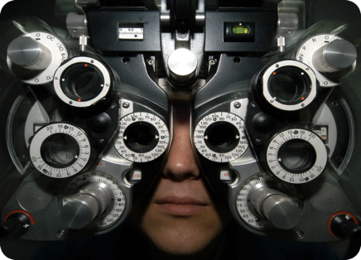
Distributional Hypothesis
If we consider optometrist and eye-doctor we find that, as our corpus of utterances grows, these two occur in almost the same environments. In contrast, there are many sentence environments in which optometrist occurs but lawyer does not...
It is a question of the relative frequency of such environments, and of what we will obtain if we ask an informant to substitute any word he wishes for optometrist (not asking what words have the same meaning).
These and similar tests all measure the probability of particular environments occurring with particular elements... If A and B have almost identical environments we say that they are synonyms.
–Zellig Harris (1954)
“You shall know a word by the company it keeps!”
–John Firth (1957)

Slide 82
Word-word matrix
Turney and Pantel (2010) From Frequency to Meaning: If units of text have similar vectors in a text-frequency matrix then they tend to have similar meanings.
Notes:
Rows: Abandon, Abdicate, Abhore, Academic … Zygodactyl, Zymergy
Columns: Abandon, Abdicate, Abhore, Academic … Zygodactyl, Zymergy

Slide 83
Defining a co-occurrence matrix
Notes:
Context window
Co-occur in the same document
Co-occur in the same sentence
Co-occur in the same window of words
More complex contexts like dependency patterns

Slide 84
DIRT
Lin and Panel (2001) operationalize the Distributional Hypothesis using dependency relationships to define similar environments.
Duty and responsibility share a similar set of dependency contexts in large volumes of text:
modified by adjectives | objects of verbs
additional, administrative, assigned, assumed, collective, congressional, constitutional ... | assert, assign, assume, attend to, avoid, become, breach ...

Slide 85
Define a co-occurrence matrix
…
…

Slide 86
Term-context matrix for word similarity
Two words are similar in meaning if their context vectors are similar

Slide 87
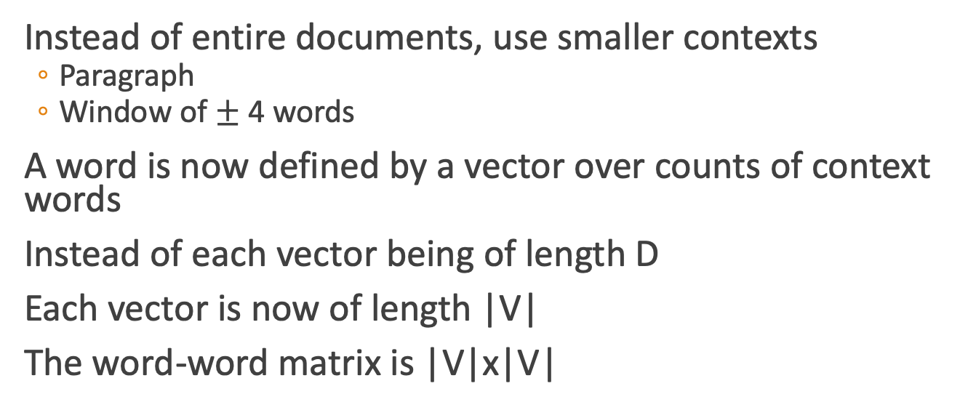
The word-word or word-context matrix
Instead of entire documents, use smaller contexts
Paragraph
Window of $±$ 4 words
A word is now defined by a vector over counts of context words
Instead of each vector being of length D
Each vector is now of length |V|
The word-word matrix is |V|x|V|

Slide 88
Word-word matrix
We showed only 4x6, but the real matrix is 50,000 x 50,000
So it’s very sparse
Most values are 0.
That’s OK, since there are lots of efficient algorithms for sparse matrices.
The size of windows depends on your goals
The shorter the windows , the more syntactic the representation
$±$ 1-3 very syntacticy
The longer the windows, the more semantic the representation
$±$ 4-10 more semanticy

Slide 89
Related versus similar
Related words
They are typically nearby each other.
wrote is related to words like book or poem.
Similar words
They have similar neighbors.
wrote is similar to words like said or remarked.

Slide 90
Vector Semantics
Measuring similarity: the cosine

Slide 91
Measuring similarity
Given 2 target words v and w
We’ll need a way to measure their similarity.
Most measure of vectors similarity are based on the:
Dot product or inner product from linear algebra
High when two vectors have large values in same dimensions.
Low (in fact 0) for orthogonal vectors with zeros in complementary distribution

Slide 92
Problem with dot product
Dot product is longer if the vector is longer. Vector length:
Vectors are longer if they have higher values in each dimension
That means more frequent words will have higher dot products
That’s bad: we don’t want a similarity metric to be sensitive to word frequency

Slide 93
Solution: cosine
Just divide the dot product by the length of the two vectors!
This turns out to be the cosine of the angle between them!

Slide 94
Cosine for computing similarity
Sec. 6.3
Dot product
Unit vectors
v_{i} is the PPMI value for word v in context i
w_{i} is the PPMI value for word w in context i.
Cos(v,w) is the cosine similarity of v and w

Slide 95
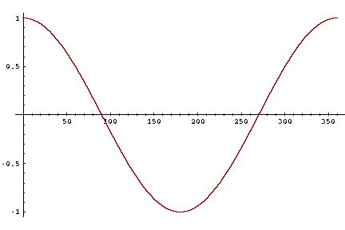
Cosine as a similarity metric
-1: vectors point in opposite directions
+1: vectors point in same directions
0: vectors are orthogonal
Raw frequency is non-negative, so cosine ranges between 0 and 1

Slide 96
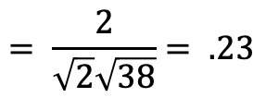
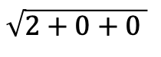
 | large | data | computer
apricot | 2 | 0 | 0
digital | 0 | 1 | 2
information | 1 | 6 | 1
Which pair of words is more similar?
cosine(apricot,information) =
cosine(digital,information) =
cosine(apricot,digital) =
$$2+0+0$$
$$= \frac{2}{\sqrt{2}\sqrt{38}}= .23$$
$$\sqrt{2+0+0 }$$

Slide 97
Visualizing vectors and angles
 | large | data
apricot | 2 | 0
digital | 0 | 1
information | 1 | 6

Slide 98
Clustering vectors to visualize similarity in co-occurrence matrices
Rohde et al. (2006)

Slide 99
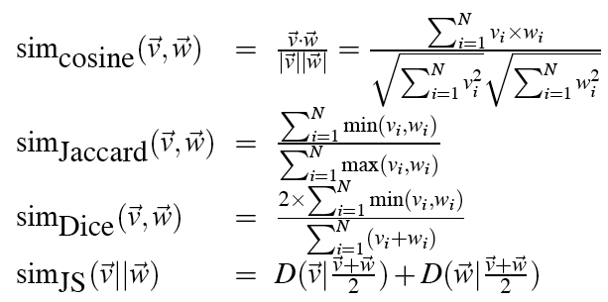
Other possible similarity measures

Slide 100
Vector Semantics
Measuring similarity: the cosine

Slide 101
Using syntax to define a word’s context
Zellig Harris (1968)
“The meaning of entities, and the meaning of grammatical relations among them, is related to the restriction of combinations of these entities relative to other entities”
Two words are similar if they have similar syntactic contexts
Duty and responsibility have similar syntactic distribution:
Modified by adjectives | additional, administrative, assumed, collective, congressional, constitutional …
Objects of verbs | assert, assign, assume, attend to, avoid, become, breach..

Slide 102
Co-occurrence vectors based on syntactic dependencies
Dekang Lin, 1998 “Automatic Retrieval and Clustering of Similar Words”
Each dimension: a context word in one of R grammatical relations
Subject-of- “absorb”
Instead of a vector of |V| features, a vector of R|V|
Example: counts for the word cell :

Slide 103
Syntactic dependencies for dimensions
Alternative (Padó and Lapata 2007):
Instead of having a |V| x R|V| matrix
Have a |V| x |V| matrix
But the co-occurrence counts aren’t just counts of words in a window
But counts of words that occur in one of R dependencies (subject, object, etc).
So M(“cell”,”absorb”) = count(subj(cell,absorb)) + count(obj(cell,absorb)) + count(pobj(cell,absorb)), etc.

Slide 104
TF-IDF
tf-idf (that’s a hyphen not a minus sign)
The combination of two factors
Term frequency (Luhn 1957): frequency of the word (can be logged)
Inverse document frequency (IDF) (Sparck Jones 1972)
N is the total number of documents
df_{i} = “document frequency of word i”
= # of documents with word I
w_{ij} = word i in document j
w_{ij}=tf_{ij} idf_{i}

Slide 105
TF-IDF
TF-IDF not generally used for word-word similarity
But is by far the most common weighting when we are considering the relationship of words to documents

Slide 106
Vector Semantics
Positive Pointwise Mutual Information (PPMI)

Slide 107
Problem with raw counts
Raw word frequency is not a great measure of association between words
It’s very skewed
“the” and “of” are very frequent, but maybe not the most discriminative
We’d rather have a measure that asks whether a context word is particularly informative about the target word.
Positive Pointwise Mutual Information (PPMI)

Slide 108
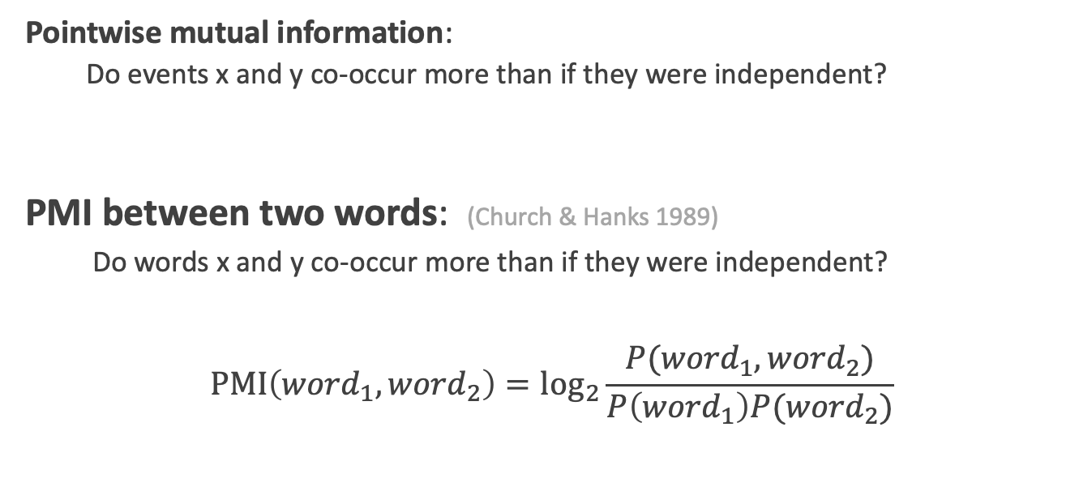
Pointwise Mutual Information
Pointwise mutual information:
Do events x and y co-occur more than if they were independent?
PMI between two words: (Church & Hanks 1989)
Do words x and y co-occur more than if they were independent?
$$\text{PMI}\left({word}_{1}, {word}_{2}\right)={\text{log}}_{2}\frac{P({word}_{1}, {word}_{2})}{P\left({word}_{1}\right)P({word}_{2})}$$

Slide 109
PMI applied to dependency relations
Hindle, Don. 1990. Noun Classification from Predicate-Argument Structure. ACL
Object of “drink” | Count | PMI
it | 3 | 1.3
anything | 3 | 5.2
wine | 2 | 9.3
tea | 2 | 11.8
liquid | 2 | 10.5
Object of “drink” | Count | PMI
tea | 2 | 11.8
liquid | 2 | 10.5
wine | 2 | 9.3
anything | 3 | 5.2
it | 3 | 1.3
“Drink it” more common than “drink wine”
But “wine” is a better “drinkable” thing than “it”

Slide 110
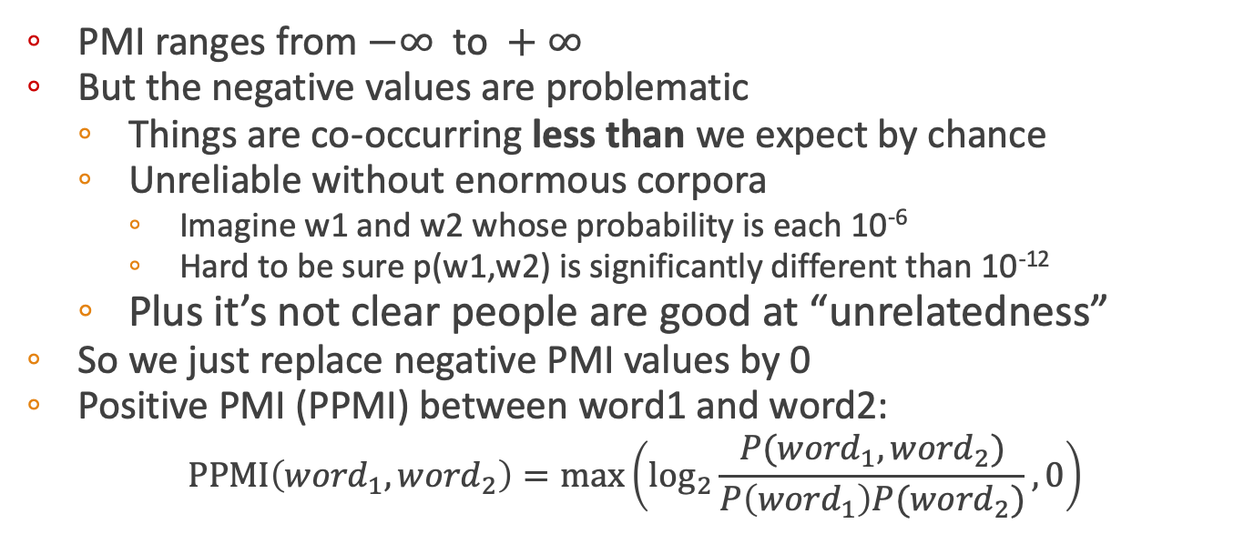
Positive Pointwise Mutual Information
PMI ranges from $−∞ \text{to} +∞$
But the negative values are problematic
Things are co-occurring less than we expect by chance
Unreliable without enormous corpora
Imagine w1 and w2 whose probability is each 10⁻⁶
Hard to be sure p(w1,w2) is significantly different than 10⁻¹²
Plus it’s not clear people are good at “unrelatedness”
So we just replace negative PMI values by 0
Positive PMI (PPMI) between word1 and word2:
$$\text{PPMI}\left({word}_{1}, {word}_{2}\right)=\max\left({\text{log}}_{2}\frac{P({word}_{1}, {word}_{2})}{P\left({word}_{1}\right)P({word}_{2})},0\right)$$

Slide 111
Computing PPMI on a term-context matrix
Matrix F with W rows (words) and C columns (contexts)
f_{ij} is # of times w_{i} occurs in context c_{j}

Slide 112
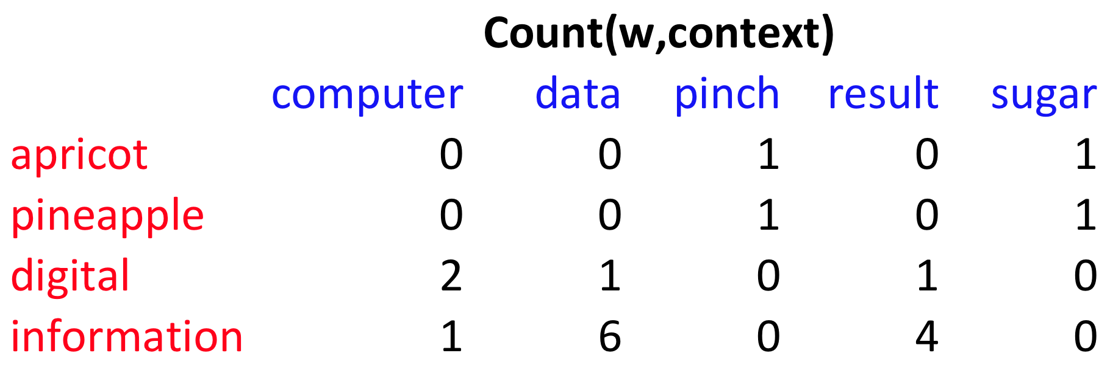
p(w=information,c=data) =
p(w=information) =
p(c=data) =
6/19
= .32
11/19
= .58
7/19
= .37

Slide 113
pmi(information,data) = log₂ (
.32 /
(.37*.58) )
= .58
(.57 using full precision)

Slide 114
Weighting PMI
PMI is biased toward infrequent events
Very rare words have very high PMI values
Two solutions:
Give rare words slightly higher probabilities
Use add-one smoothing (which has a similar effect)

Slide 115
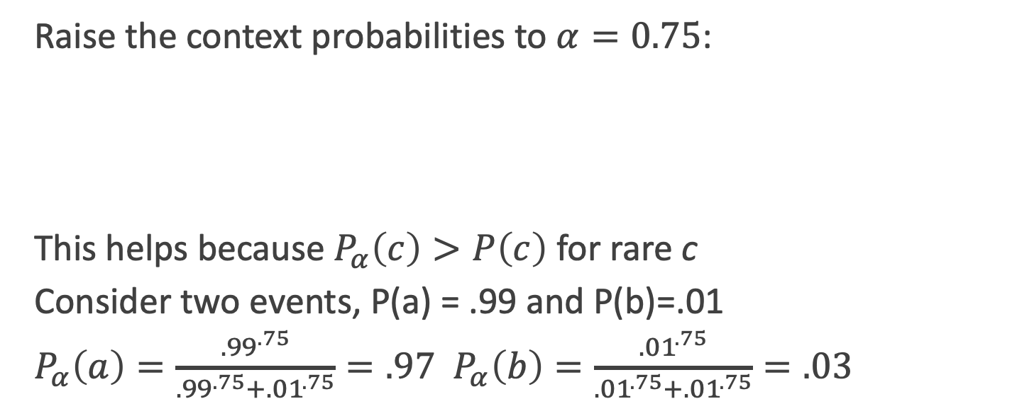
Weighting PMI: Giving rare context words slightly higher probability
Raise the context probabilities to $α=0.75$:
This helps because $P_{α}\left(c\right)>P\left(c\right)$ for rare c
Consider two events, P(a) = .99 and P(b)=.01
$P_{α}\left(a\right)=\frac{{.99}^{.75}}{{.99}^{.75}+{.01}^{.75}}=.97$ $P_{α}\left(b\right)=\frac{{.01}^{.75}}{{.01}^{.75}+{.01}^{.75}}=.03$

Slide 116
Use Laplace (add-1) smoothing

Slide 118
PPMI versus add-2 smoothed PPMI

Slide 119
Vector Semantics
Evaluating similarity

Slide 120
Evaluating similarity
Extrinsic (task-based, end-to-end) Evaluation:
Question Answering
Spell Checking
Essay grading
Intrinsic Evaluation:
Correlation between algorithm and human word similarity ratings
Wordsim353: 353 noun pairs rated 0-10. sim(plane,car)=5.77
Taking TOEFL multiple-choice vocabulary tests
Levied is closest in meaning to:
imposed, believed, requested, correlated

Slide 121
Summary
Distributional (vector) models of meaning
Sparse (PPMI-weighted word-word co-occurrence matrices)
Dense: Next lecture!

